Slide 1
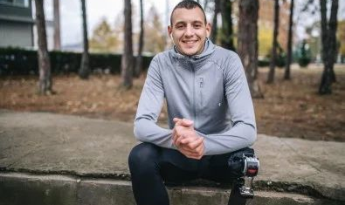
LEEDS MENTAL WELLBEING SERVICE
REFERRER UPDATE
NEWSLETTER
Quarter 4 April 2025
PRIMARY CARE MENTAL HEALTH UPDATE
PCMH SYSTEMS -TASKING UPDATE
PCMH use Systm/EMIS – if you can’t see what the plan is for a patient from shared record, and/or need an update for a patient we already have a referral for please TASK us.
EMIS surgeries: please use Internal tasks to PCMH Task Group in your system- (avoid tasking an individual)
SystmOne Surgeries: ‘Leeds Mental Wellbeing Service’ should be a Task option if the patient has Open Referral. Tasks you send on SystmOne will drop into the correct PCN inbox (by Practice) so you don’t need to search for individual staff name etc.
PCMH REFERRAL UPDATE
Primary Care Mental Health have received a higher number of referrals over the last quarter than in previous months. Therefore, response time to contact or for subsequent interventions for patients are increasing. This varies between PCN’s and teams.
Some patients are waiting over 2 weeks before first contact call.
Wait for subsequent interventions are up to 12 weeks in some cases and PCNs.
We are doing all that we can to get on top of this increase in referrals over the next few months.
We kindly ask for your support and patience during these busy times.
If you have any questions, please contact us on lmws.pcmh@nhs.net
PATIENT FEEDBACK
Great service. Even within 3 sessions it helped a lot with my situation and tips on dealing with different situations.
My experience was overall very good because I felt valued and heard. I learned a lot of new things to help me cope which has made a direct impact with relationships at home. However I discussed that I still believe medication will be beneficial. I have been referred for counselling which is good. The primary care team member was lovely.
INTRODUCING OUR STAFF
We would like to introduce you to our staff in the East Hub. Please see links below for staff contact sheets.
The service was extremely useful and helped me recognise and regulate my emotions and responses in a much better way.

Slide 2
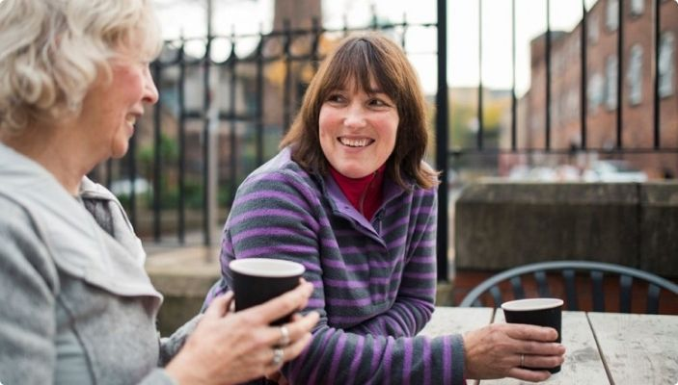
LEEDS MENTAL WELLBEING SERVICE
PRIMARY CARE GROUPS
NEW Wellbeing Course - aims to help people to better understand their particular mental health difficulty and manage emotions/feelings more effectively. Suitable for most MH presentations. 5 week course.
NEW Reset your Relationship with Eating - A 10 week group for people who have mild to moderate difficulties with eating who may not meet criteria for Connect.
NEW Unusual Sensory Experience Group – a 12 week group specifically aimed at people from ethnically diverse backgrounds.
Dealing with Feelings Group – 10 weeks
Skills for Life (DBT Intro) – 10 weeks
Wellness & Recovery Action Planning (WRAP) - 10 weeks
If a patient could benefit from these courses, a referral into PCMH is sufficient and PCMH colleagues can consider if these options are appropriate for patients.
TALKING THERAPY GROUPS
We have a range of Talking Therapies groups which may be suitable for your patients. Our team of Therapists and Wellbeing practitioners are delivering a course to support patients to improve their feelings using principles of CBT alongside Islamic teachings from the Quran and Hadith. For more information, please see info below.
FURTHER PCMH INFO
If you would like further information about PCMH please contact:
Fiaz Amin - South Hub Ops Manager
Adam Ambrose - South Hub Deputy Manager
Danni Brett - East Hub Ops Manager
Charlotte Bateman - East Hub Deputy Ops Manager
Daryll Cocking - West Hub Ops Manager
Tobias Reece - West Hub Deputy Manager
Contact: lmws.pcmh@nhs.net
NEW WEBSITE
Our website has been updated - please take a look at our new look!
https://leedsmentalwellbeingservice.co.uk/

Slide 3
LEEDS MENTAL WELLBEING SERVICE
TALKING THERAPIES UPDATE
Complete detailed online or telephone assessment Tel: 0113 843 4388 OR Self Referral or Professional.
Pregnant women, new mums and partners of, Veterans & Anyone Over 75 have priority in LMWS TT.
Patients are offered a range of ways to access support including Face to Face, Telephone, Video, SMS.
Unfortunately Talking Therapies are unable to offer support for those who are already under the care of other mental health services, such as CMHT, and cannot offer support with diagnosis, prescription queries or management of severe mental illnesses. We do however accept referrals for patients with stable SMI where depression or an anxiety disorder are the primary focus for treatment.
Current Therapy Interventions | Average Wait times and Suitability
CBT (online) Silvercloud | 5 weeks (Mild- Moderate Common MH disorder)
Guided Self Help - CBT (phone or face to face) | 10-12 weeks (Mild-Moderate Common MH disorder)
1:1 online ‘typed’ CBT - IESO | 2 weeks (Moderate Common MH disorder)
1:1 CBT (phone or Video) via partners XYLA or IESO (subject to eligibility criteria) | 3-4 months (Mod-Severe Common MH disorder)
1:1 CBT (face to face, phone or video) via main service | 5-6 months (if patient has wide availability) (Mod-Severe Common MH disorder)
Counselling for Depression (online or F2F) | 5 months (offered after Guided CBT as a step up)
Step 3 Groups: CBT for Social Anxiety (face to face) CBT for GAD - online Mindfulness based CBT - online | 3-6 months (Moderate to Severe Common MH disorder)
The Following can be booked directly from our website HERE
Direct Access courses and classes | Average Waits and access info
Online courses - Panic Attacks, Stress and Anxiety, Depression, Self-Esteem, Bereavement, Stress in Parenthood, Post Natal Depression | Available 24/7 - (can be accessed on laptop, tablet, smartphone etc)
Online Workshops – single session 2hr workshop Sleep Well Struggling with Motivation Unhelpful thinking in Low Mood Managing Worry Managing Panic Managing Stress | Up to 6 weeks – rolling programme *Run on MS Teams Live -Patients are not required to actively participate in classes or download any app.
Online & Face to Face Classes - 6-8 weeks Depression Recovery GAD Recovery Group Overcoming Stress & Low Mood Overcoming Low Mood using Islam (Face to Face -January start- can express interest now) | Up to 6-8weeks – daytime and evening classes Alternate with Remote & Face to Face Clinics Remote *Run on MS Teams Live -Patients are not required to actively participate in classes or download any app.
For our quick glance GP Adult Mental Health Referrer Guide
click the Word document here!

